Slide 1
HR Analytics Dashboard
By Omer Mazor

Slide 2
Agenda
01
Demographics
02
Turnover Analysis 1
03
Turnover Analysis II
04
Employee Wellness

Slide 3
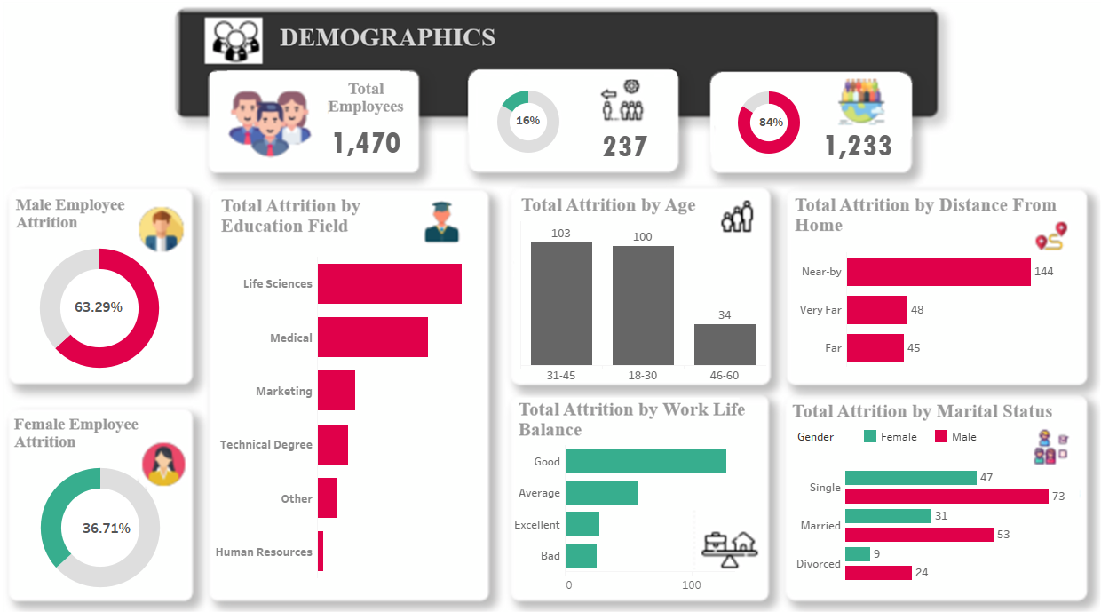
Dashboard 1 “Introduction”
Introduction
Welcome to the Employee Demographics Dashboard, where we delve into key aspects of our workforce. This comprehensive analysis sheds light on the demographic composition, attrition trends, and various factors influencing employee retention. By exploring detailed metrics, we aim to gain insights that will guide strategic decisions for fostering a healthier work environment and optimizing employee satisfaction.

Slide 4
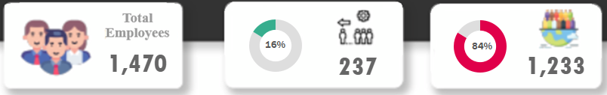
Total Employees & Attrition Overview
This slide presents an overview of the total workforce, highlighting the distinct count of employee numbers. With a total of 1,470 employees, we set the stage for a closer examination of the factors influencing our organizational dynamics.
Dive into the attrition landscape with a breakdown of the distinct count of employee numbers who have left the organization—237 employees, marking a critical point for understanding and addressing retention challenges.
Contrast the attrition data with a focus on employees who have chosen to stay—1,233 individuals. This provides a positive perspective, offering insights into the aspects that contribute to employee satisfaction and longevity within the company.

Slide 5
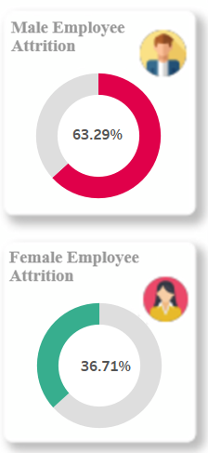
Gender-based analysis comes into play, breaking down the attrition figures by gender. With 150 male employees constituting 63.29% of the total attrition, understanding the nuances between male and female attrition becomes crucial for targeted interventions.
The breakdown for female employees, showing that 87 individuals or 36.71% contribute to the overall attrition figure. Analyzing gender-specific trends allows for tailored strategies to enhance workplace satisfaction and retention.
Attrition by Gender

Slide 6
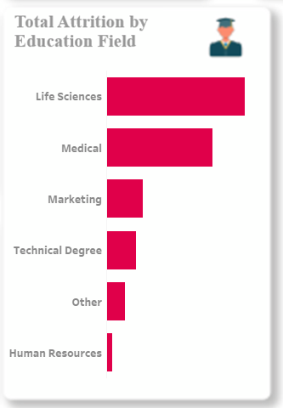
Total Attrition by Education Field
Education field influences attrition rates significantly. Explore the breakdown by fields such as Human Resources, Marketing, and Life Sciences. These insights pave the way for targeted improvements in specific educational domains.

Slide 7
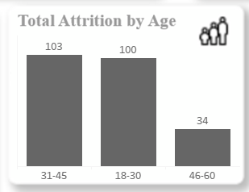
Total Attrition by Age
Understanding attrition patterns across age groups is crucial. With distinctions between age brackets (18-30, 31-45, 46-60), this slide aids in pinpointing age-related factors impacting employee retention.

Slide 8
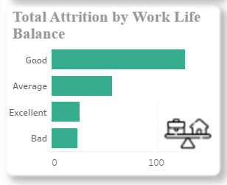
Total Attrition by Work Life Balance
Employee work-life balance is a critical determinant of job satisfaction. Assess the attrition rates across different work-life balance categories (Bad, Excellent, Average, Good) to gauge the correlation between work-life balance and employee turnover.

Slide 9
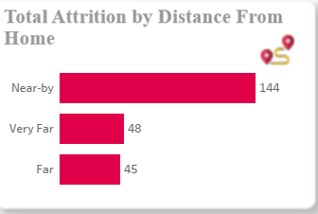
Attrition by Distance From Home
Employee commutes can impact job satisfaction and retention. Investigate attrition rates based on distance from home, categorized as Far, Near-by, and Very Far, to uncover potential correlations with geographical proximity and employee turnover.

Slide 10
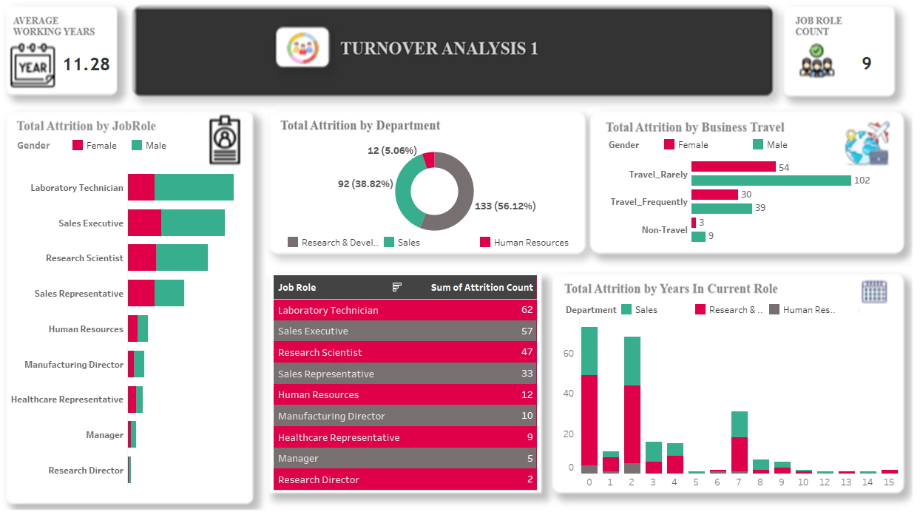
Dashboard 2 “Turnover Analysis 1”
Introduction
Welcome to Turnover Analysis, where we delve into a comprehensive analysis of turnover within the organization. This dashboard focuses on various aspects contributing to attrition, such as job roles, departments, business travel, and years in current roles. By examining these factors, we aim to uncover patterns and insights that will assist in understanding the dynamics of employee turnover and inform strategic decision-making to improve retention.

Slide 11
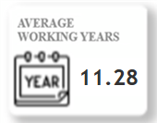
Average Working Years
the average total working years of employees in the organization. Understanding the average working years is crucial for assessing the overall experience and potential impact of seasoned employees on the workforce.

Slide 12
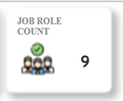
we provide a distinct count of job roles within the organization. This information is essential for understanding the diversity and distribution of roles, setting the stage for a more detailed analysis of turnover in subsequent slides.
Job Role Count

Slide 13
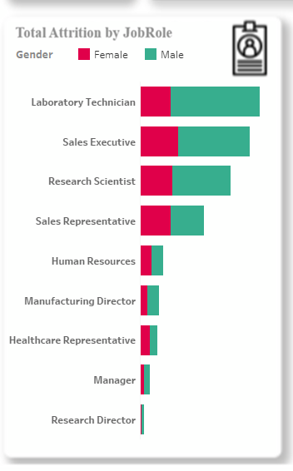
Total Attrition by Job Role
Here, we break down attrition numbers by specific job roles. Analyzing attrition at the role level allows us to identify any patterns or trends associated with particular positions and understand the impact on various functions within the organization.

Slide 14
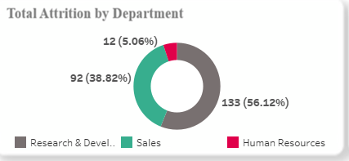
Total Attrition by Department
It explores attrition across different departments. Understanding which departments are most affected by turnover is critical for targeted interventions and resource allocation to address specific challenges within each department.

Slide 15
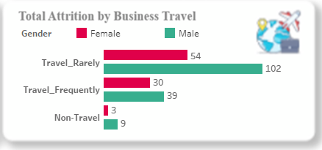
Total Attrition by Business Travel
Business travel can be a significant factor influencing attrition. Slide 16 provides a breakdown of attrition based on the frequency of business travel, shedding light on whether travel-related factors contribute to employee turnover within the organization.

Slide 16
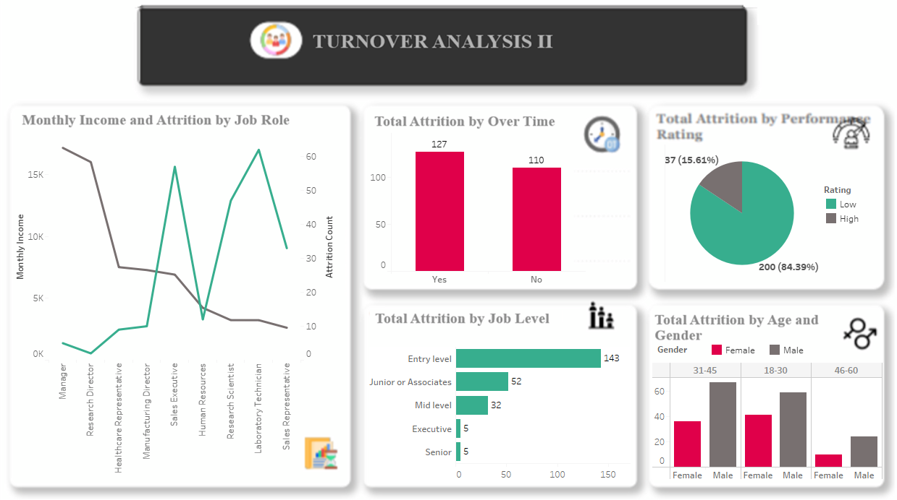
Dashboard 3 “Turnover Analysis 2”
Introduction
Welcome to Turnover Analysis 2, where we continue our in-depth exploration of turnover analysis, focusing on additional dimensions that play a crucial role in understanding and addressing employee attrition. This dashboard delves into factors such as monthly income, overtime, job level, performance rating, and the intersection of age and gender. By examining these elements, we aim to gain deeper insights into the nuanced aspects of turnover, facilitating targeted strategies for retention and talent management.

Slide 17
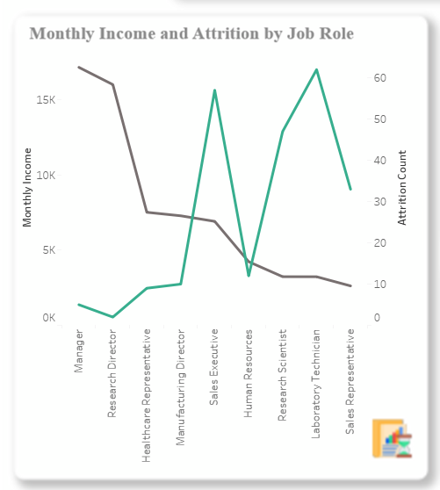
Monthly Income and Attrition by Job Role
It provides an insightful correlation between average monthly income and attrition by job role. By examining how income levels relate to turnover across various roles, we can identify potential disparities and assess whether compensation plays a role in employee retention.

Slide 18
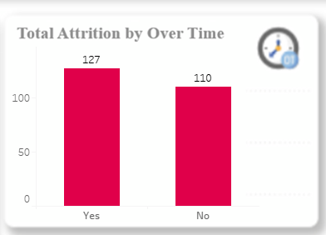
It focuses on the impact of overtime on attrition rates. By understanding how working beyond standard hours affects employee retention, organizations can tailor policies to create a healthier work-life balance and reduce turnover associated with excessive overtime.
Total Attrition by Overtime

Slide 19
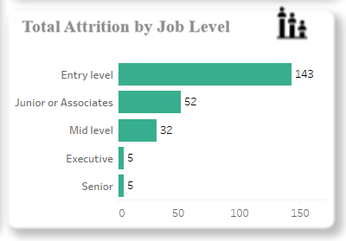
Total Attrition by Job Level
Here, we explore attrition across different job levels within the organization. Understanding which job levels are most affected by turnover provides valuable insights for talent development, succession planning, and targeted retention efforts.

Slide 20
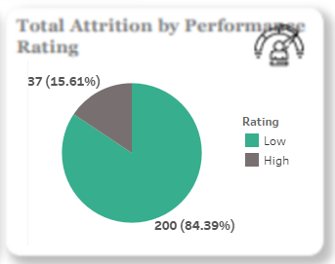
Total Attrition by Performance Rating
This slide analyzes attrition based on performance ratings, shedding light on whether employees with different performance levels exhibit varying turnover rates. This insight can guide performance management strategies and help identify areas for improvement in talent development.

Slide 21
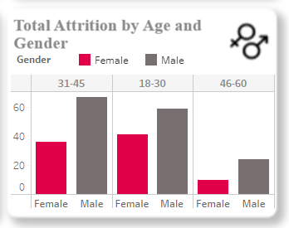
Total Attrition by Age and Gender
The final slide in this dashboard examines attrition by age and gender, offering a nuanced perspective on demographic factors influencing turnover. By understanding how age and gender intersect with attrition, organizations can implement targeted initiatives to support specific demographic groups and enhance overall workforce stability.

Slide 22
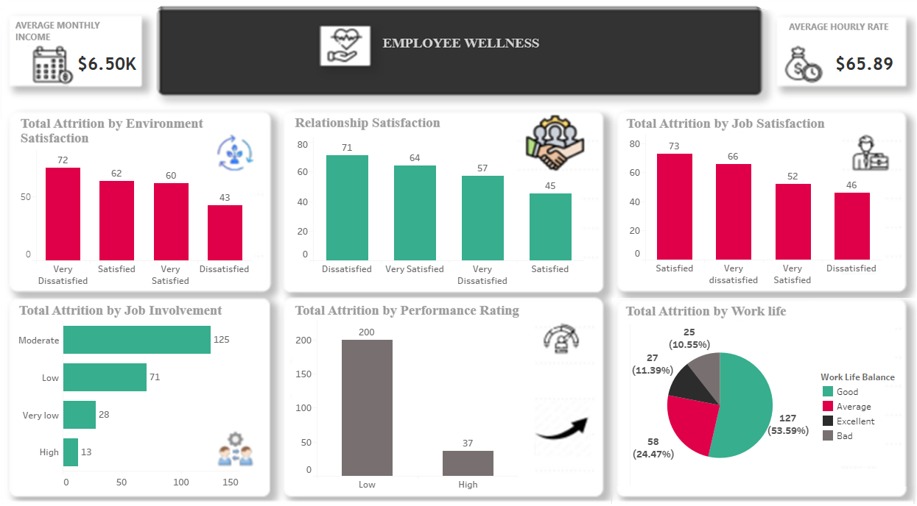
Dashboard 4 “Employee Wellness”
Introduction
Welcome to Employee Wellness, where we shift our focus to Employee Wellness, examining factors such as income, hourly rates, job satisfaction, work-life balance, and overall well-being. Understanding the holistic well-being of employees is crucial for fostering a healthy and productive work environment. This dashboard aims to uncover insights into the relationship between employee wellness factors and attrition, providing valuable information for crafting initiatives that prioritize the overall health and satisfaction of the workforce.

Slide 23
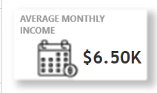
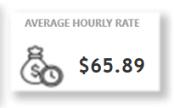
Avg. Monthly Income and Hourly Rate
It provides an overview of both average monthly income and hourly rates within the organization. Analyzing these financial aspects in tandem offers a comprehensive view of employee compensation, allowing organizations to evaluate the fairness of pay structures and their potential impact on attrition rates.

Slide 24
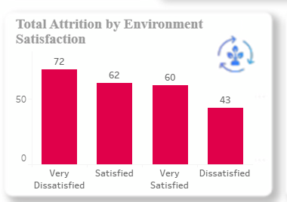
This slide explores the connection between attrition and employees' satisfaction with their work environment. By assessing the impact of environmental satisfaction on turnover, organizations can identify areas for improvement in workplace conditions, fostering a more positive and supportive atmosphere.
Total Attrition by Environment Satisfaction

Slide 25
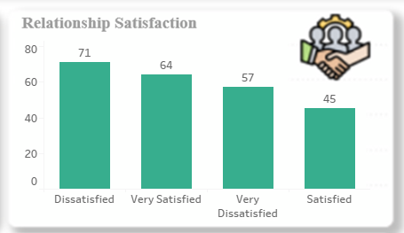
Relationship Satisfaction
we delve into the correlation between relationship satisfaction and attrition. Understanding how relationships, both professional and personal, influence employee turnover can guide efforts to enhance communication, collaboration, and interpersonal dynamics within the organization.

Slide 26
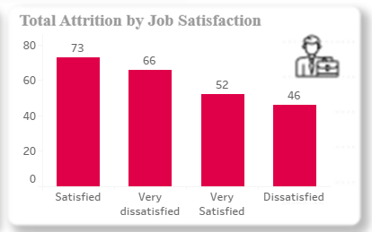
Total Attrition by Job Satisfaction
This slide analyzes the relationship between attrition and job satisfaction. By exploring the impact of job satisfaction levels on turnover, organizations can tailor strategies to improve overall job satisfaction, thereby reducing attrition rates.

Slide 27
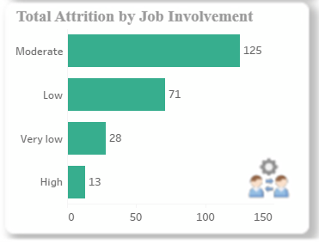
Total Attrition by Job Involvement
Here, we examine attrition in relation to job involvement. Understanding the connection between an employee's engagement with their role and turnover rates allows organizations to identify areas for improvement in job design, career development, and overall employee engagement.

Slide 28
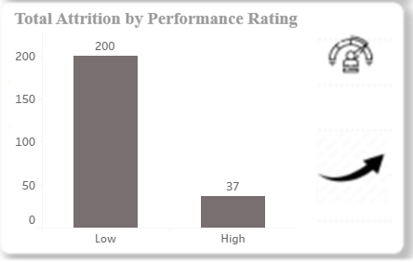
Total Attrition by Performance Rating
Here we explores the relationship between attrition and performance ratings, providing insights into how employee performance influences their decision to stay or leave. This information can inform talent development strategies and performance management initiatives.

Slide 29
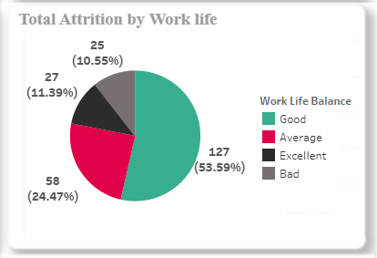
Total Attrition by Work Life Balance
Here we break down attrition based on different levels of work-life balance. By understanding how work-life balance influences turnover, organizations can implement policies and programs that support a healthier balance, contributing to employee satisfaction and retention.

Slide 30
THANK YOU

